Slide 1
Dev10 Capstone Presentation
Jesse Sasser
09/19/2025

Slide 2
Objective Statement
Problem
Fans & analysts spend too much time searching multiple sources for stats, predictions, and insights.
Solution
An interactive dashboard combining predictive models & key game features in one place.
Benefits
Efficiency – One-stop source for data & predictions
Accessibility – Complex analytics made easy to use
Better Decisions – Outperforms Vegas spread with quantified certainty

Slide 3



Datasets
CollegeFootballDatabase.com
Online database with REST API, returns information in JSON format
Covers.com
Betting Forum with frequently updated injury tables
Kaggle
CSV – Addresses gaps in stadium coordinate data

Slide 4
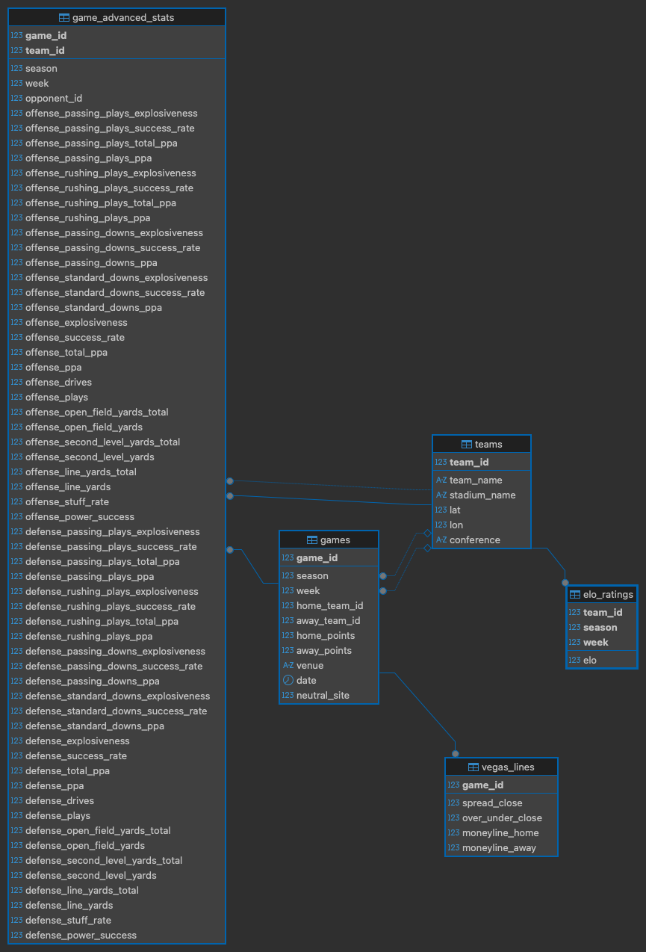
Historical Database (2014-2024)
Fetch and unpack tables for:
Games
Teams
Per Game Advanced Stats
Closing Vegas Lines
Compute Team ELO:
Starting values of 1500
Iterate through season and week

Slide 5
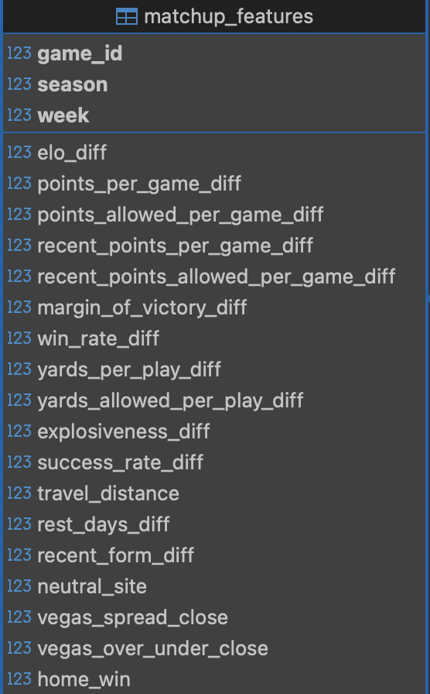
Machine Learning Approach
Derive matchup features for each game
Use only information that would have been available before the match was played
Speed could be improved through vectorization
Algorithms used
Gradient Boosting, Random Forest, ElasticNet, Logistic Regression

Slide 6
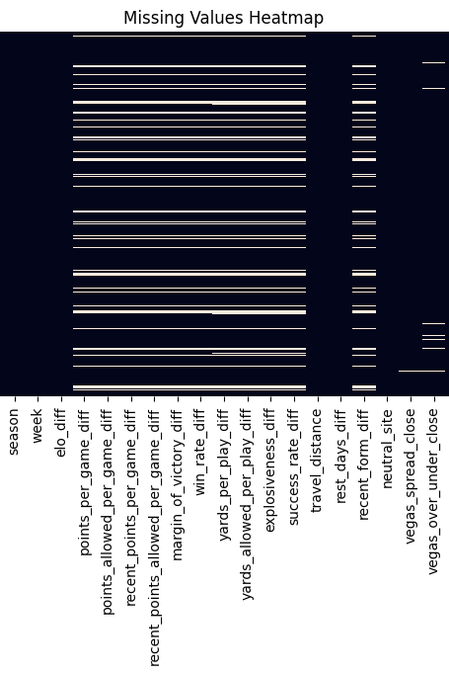
Exploratory Data Analysis
Feature Engineering process leaves missing data at start of seasons
Consistent with domain best practices (give teams time to find form)

Slide 7
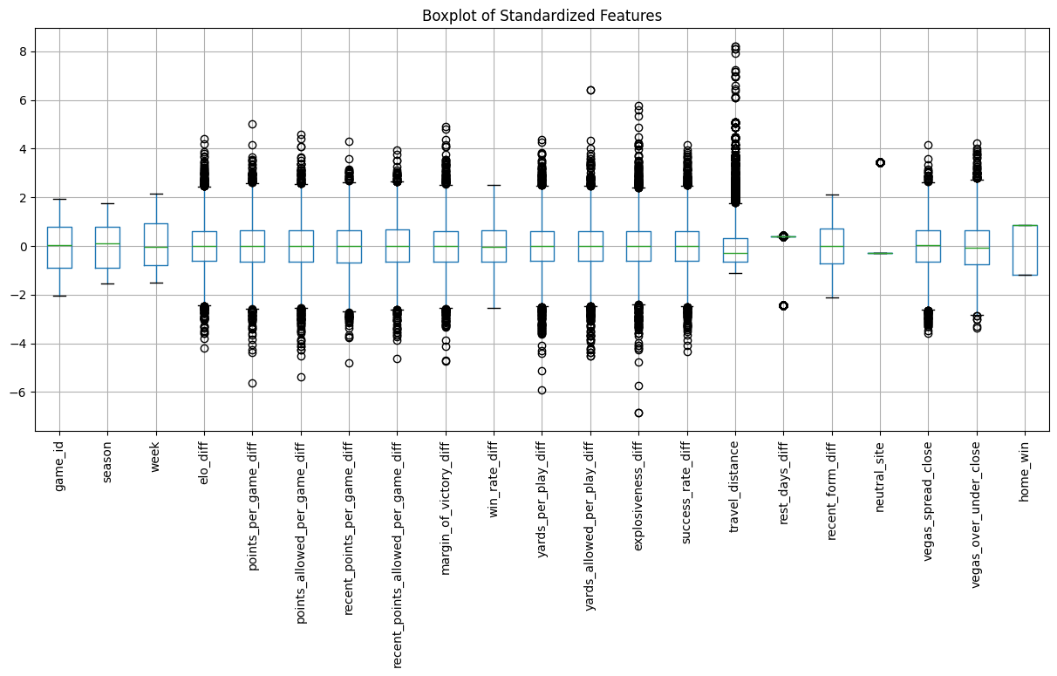
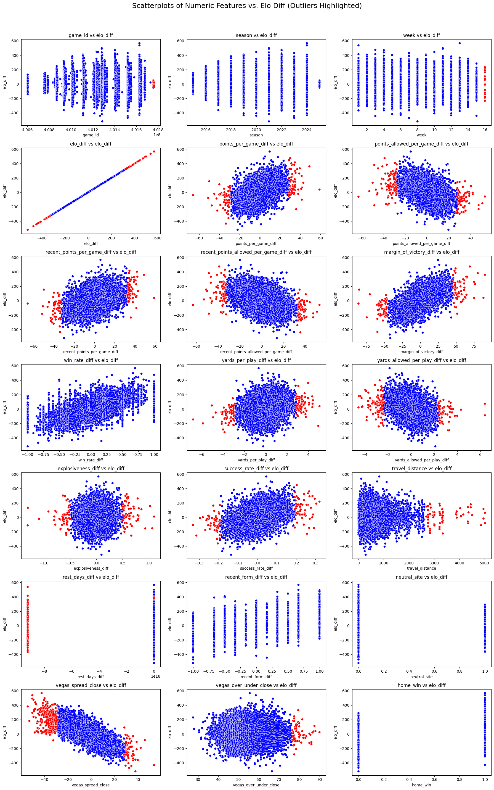
Outlier Detection
Most Features Have Outliers
Checking against ELO reveals that they’re ‘real’

Slide 8
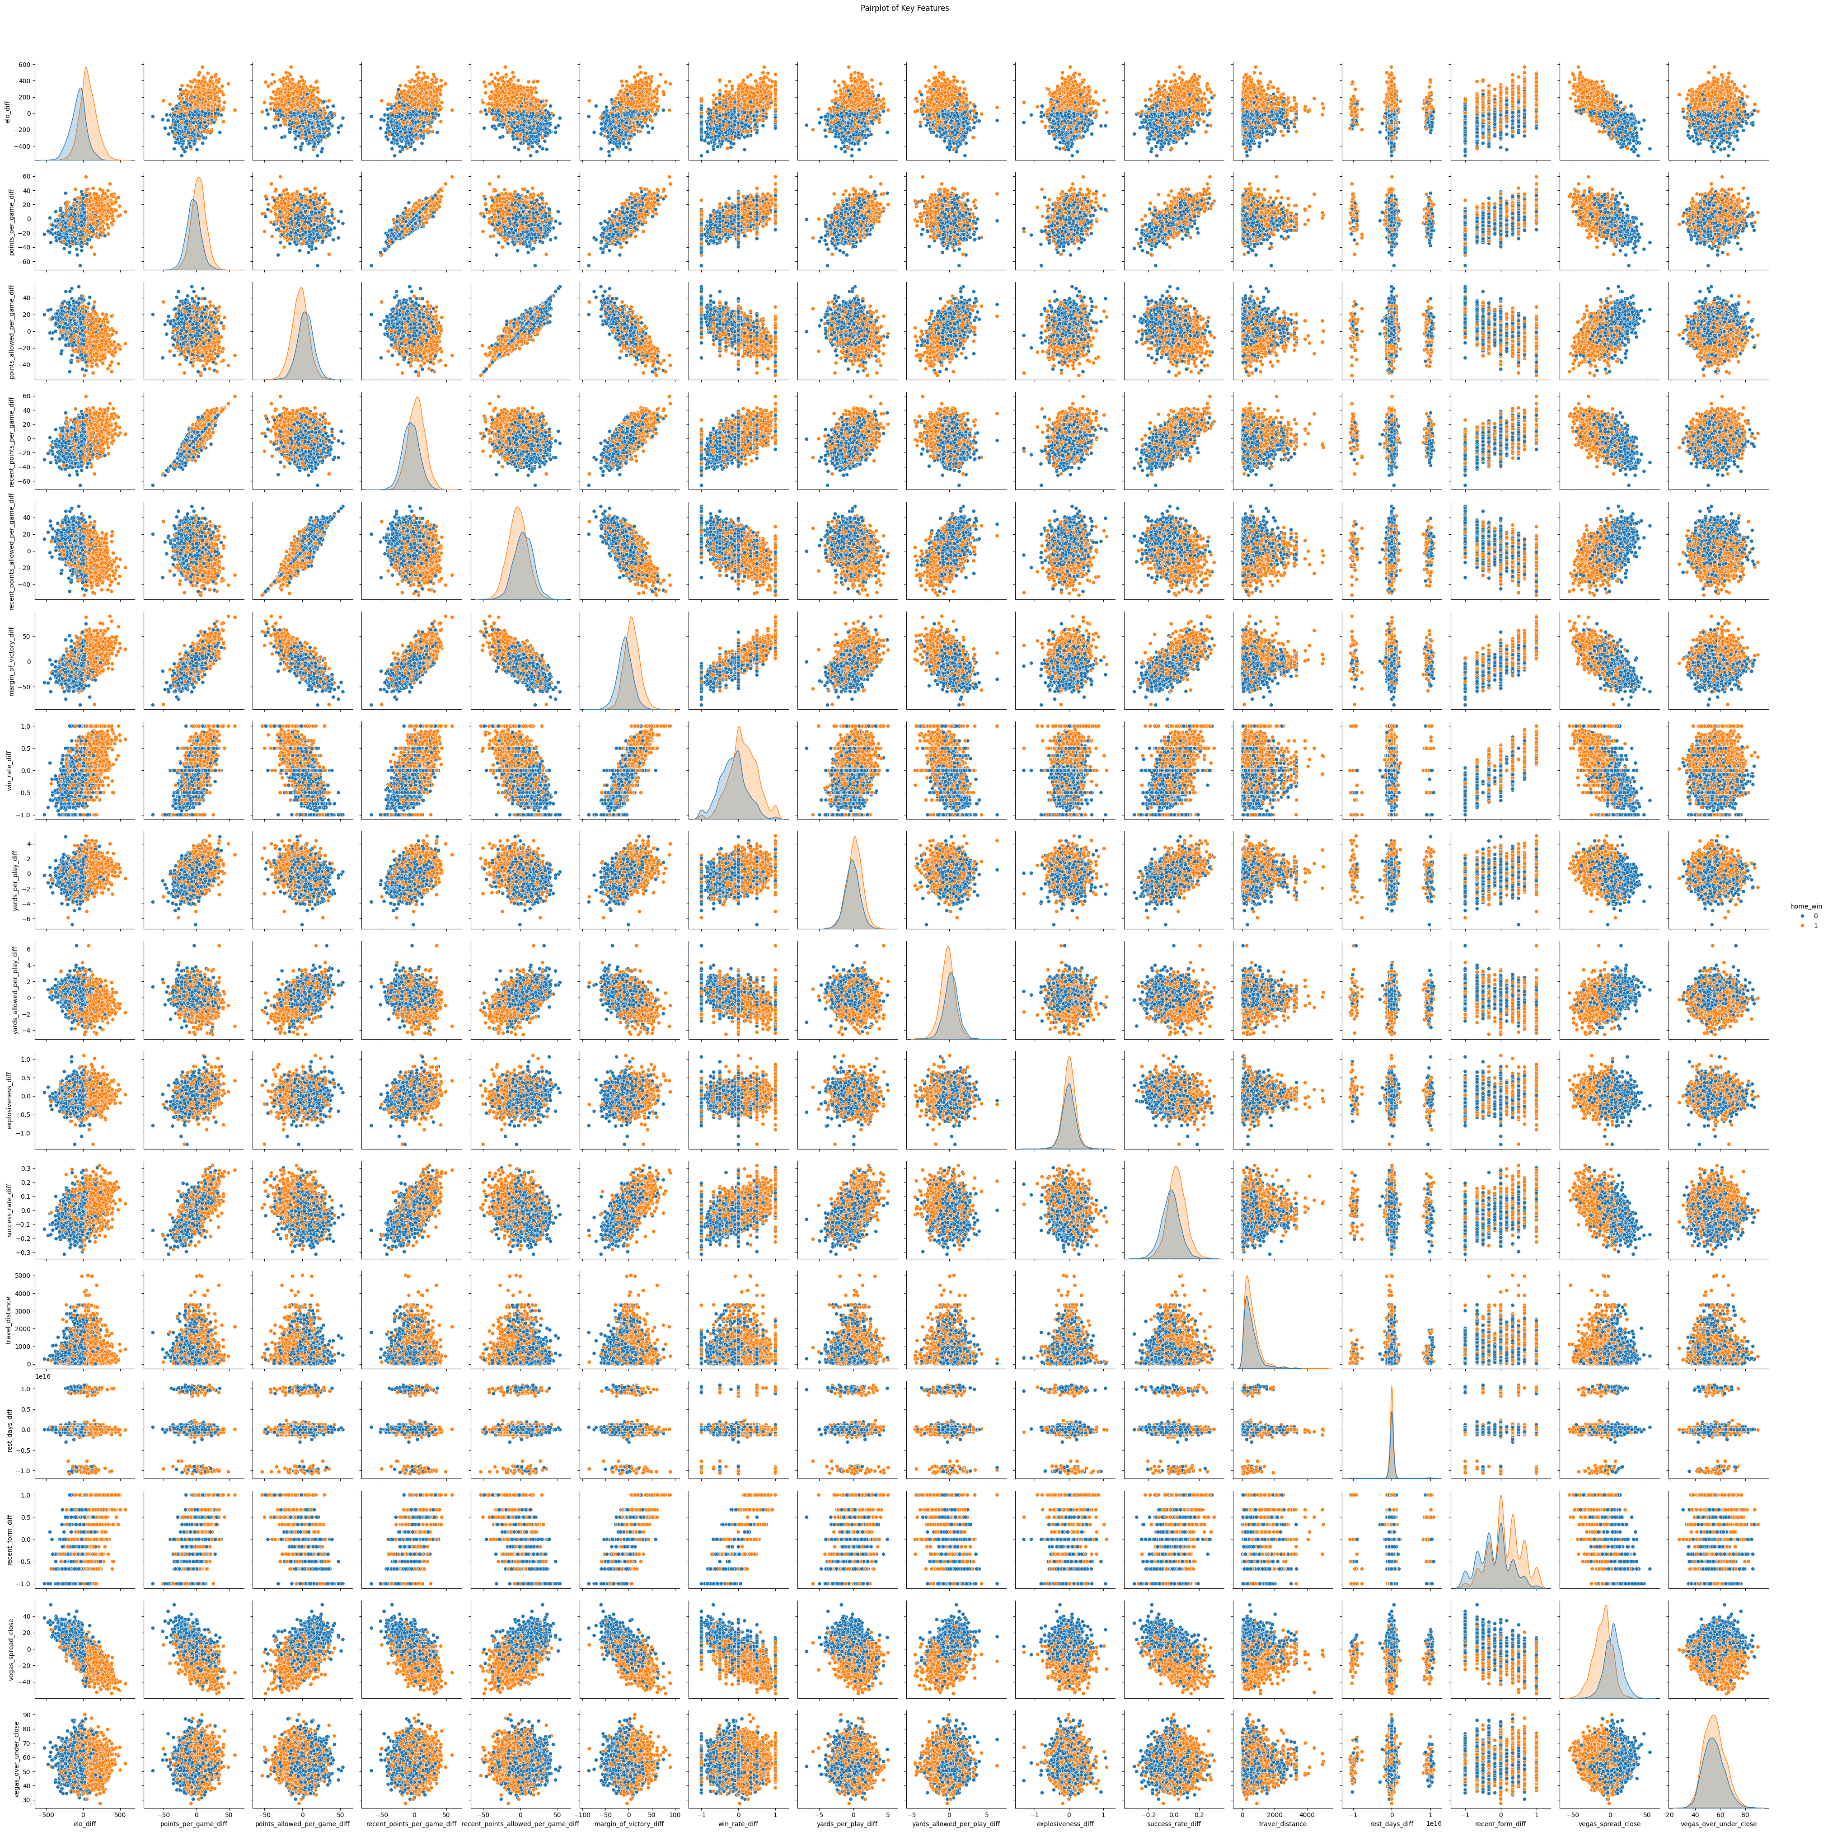

Slide 9
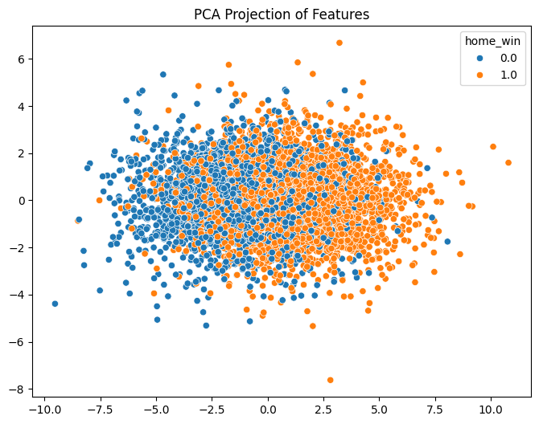

Slide 10
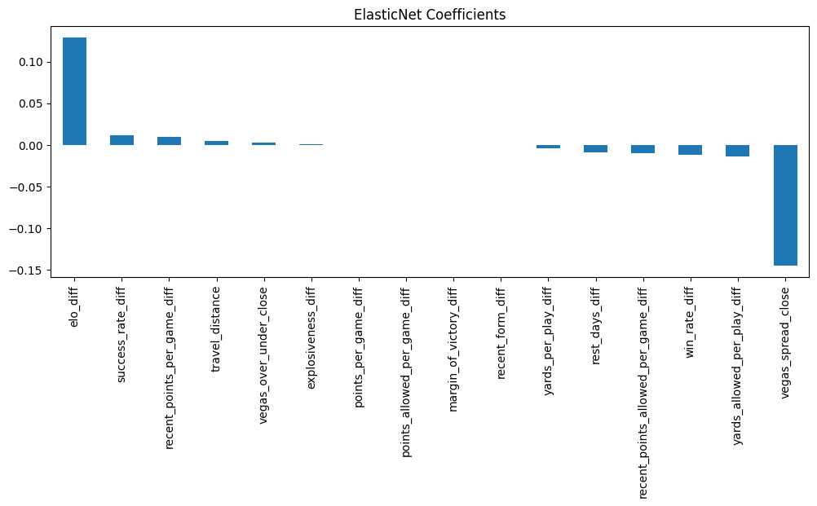
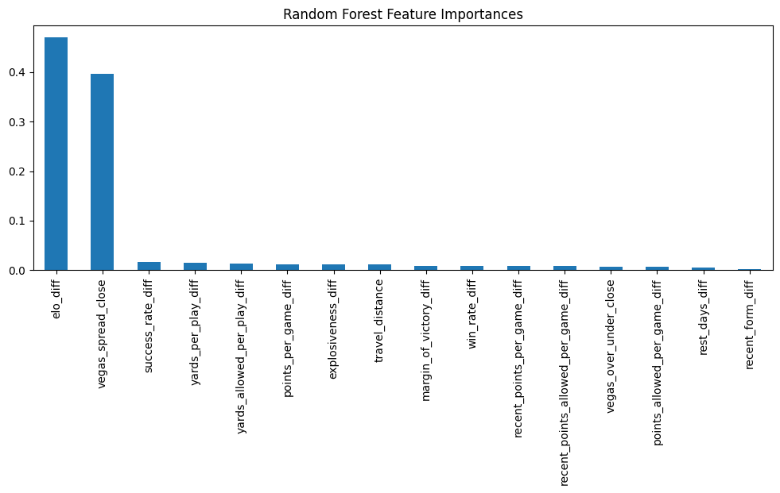
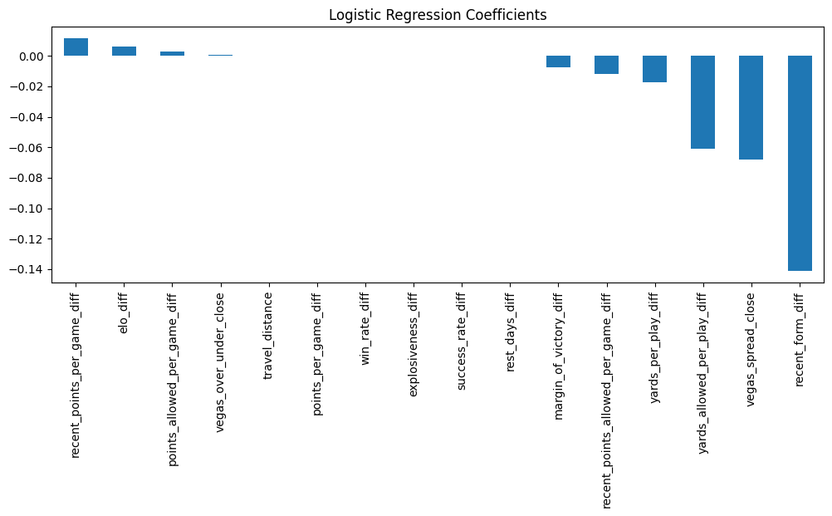
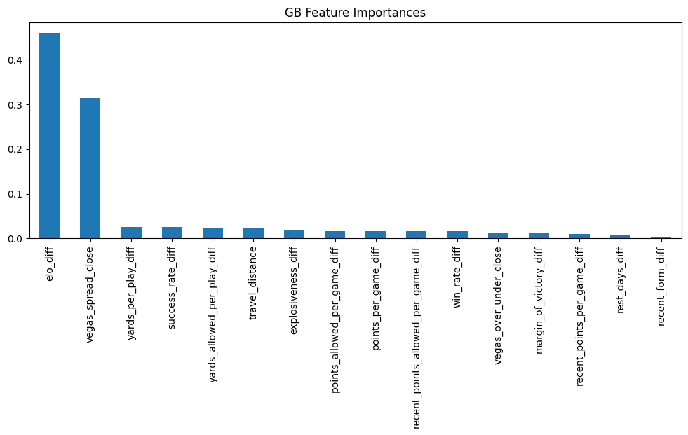

Slide 11
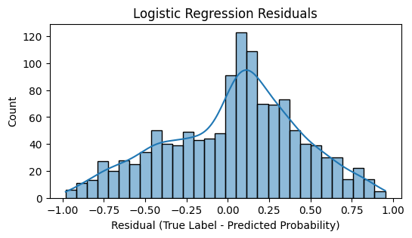
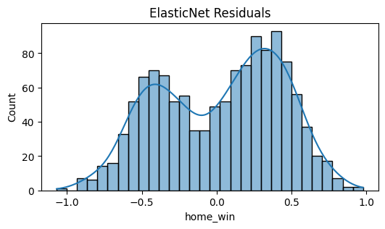
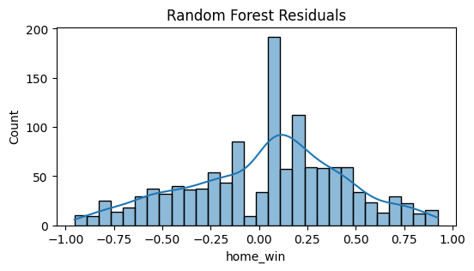
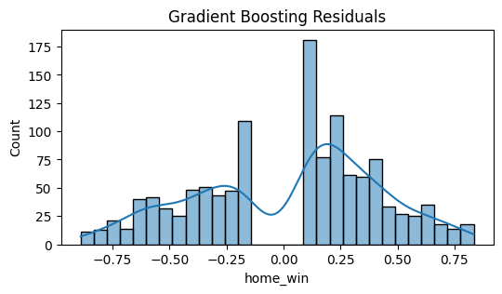

Slide 12
Results
Model | Accuracy | ROC AUC | F1 - Score | Notes
Random Forest | 0.769 | 0.832 | 0.77 | Best Overall Balance
Logistic Regression | 0.763 | 0.829 | 0.76 | Slightly Lower
Gradient Boosting | 0.763 | 0.833 | 0.76 | Similar to RF
ElasticNet Regression | ----- | ----- | ----- | RMSE: 0.41, MAE: 0.36, R²: 0.30
Vegas Spread Rule | 0.75 | 0.74 | 0.75 | Baseline heuristic

Slide 13




Weekly Game Updates

Slide 14



Live Line Updates

Slide 15



Injury Updates

Slide 16
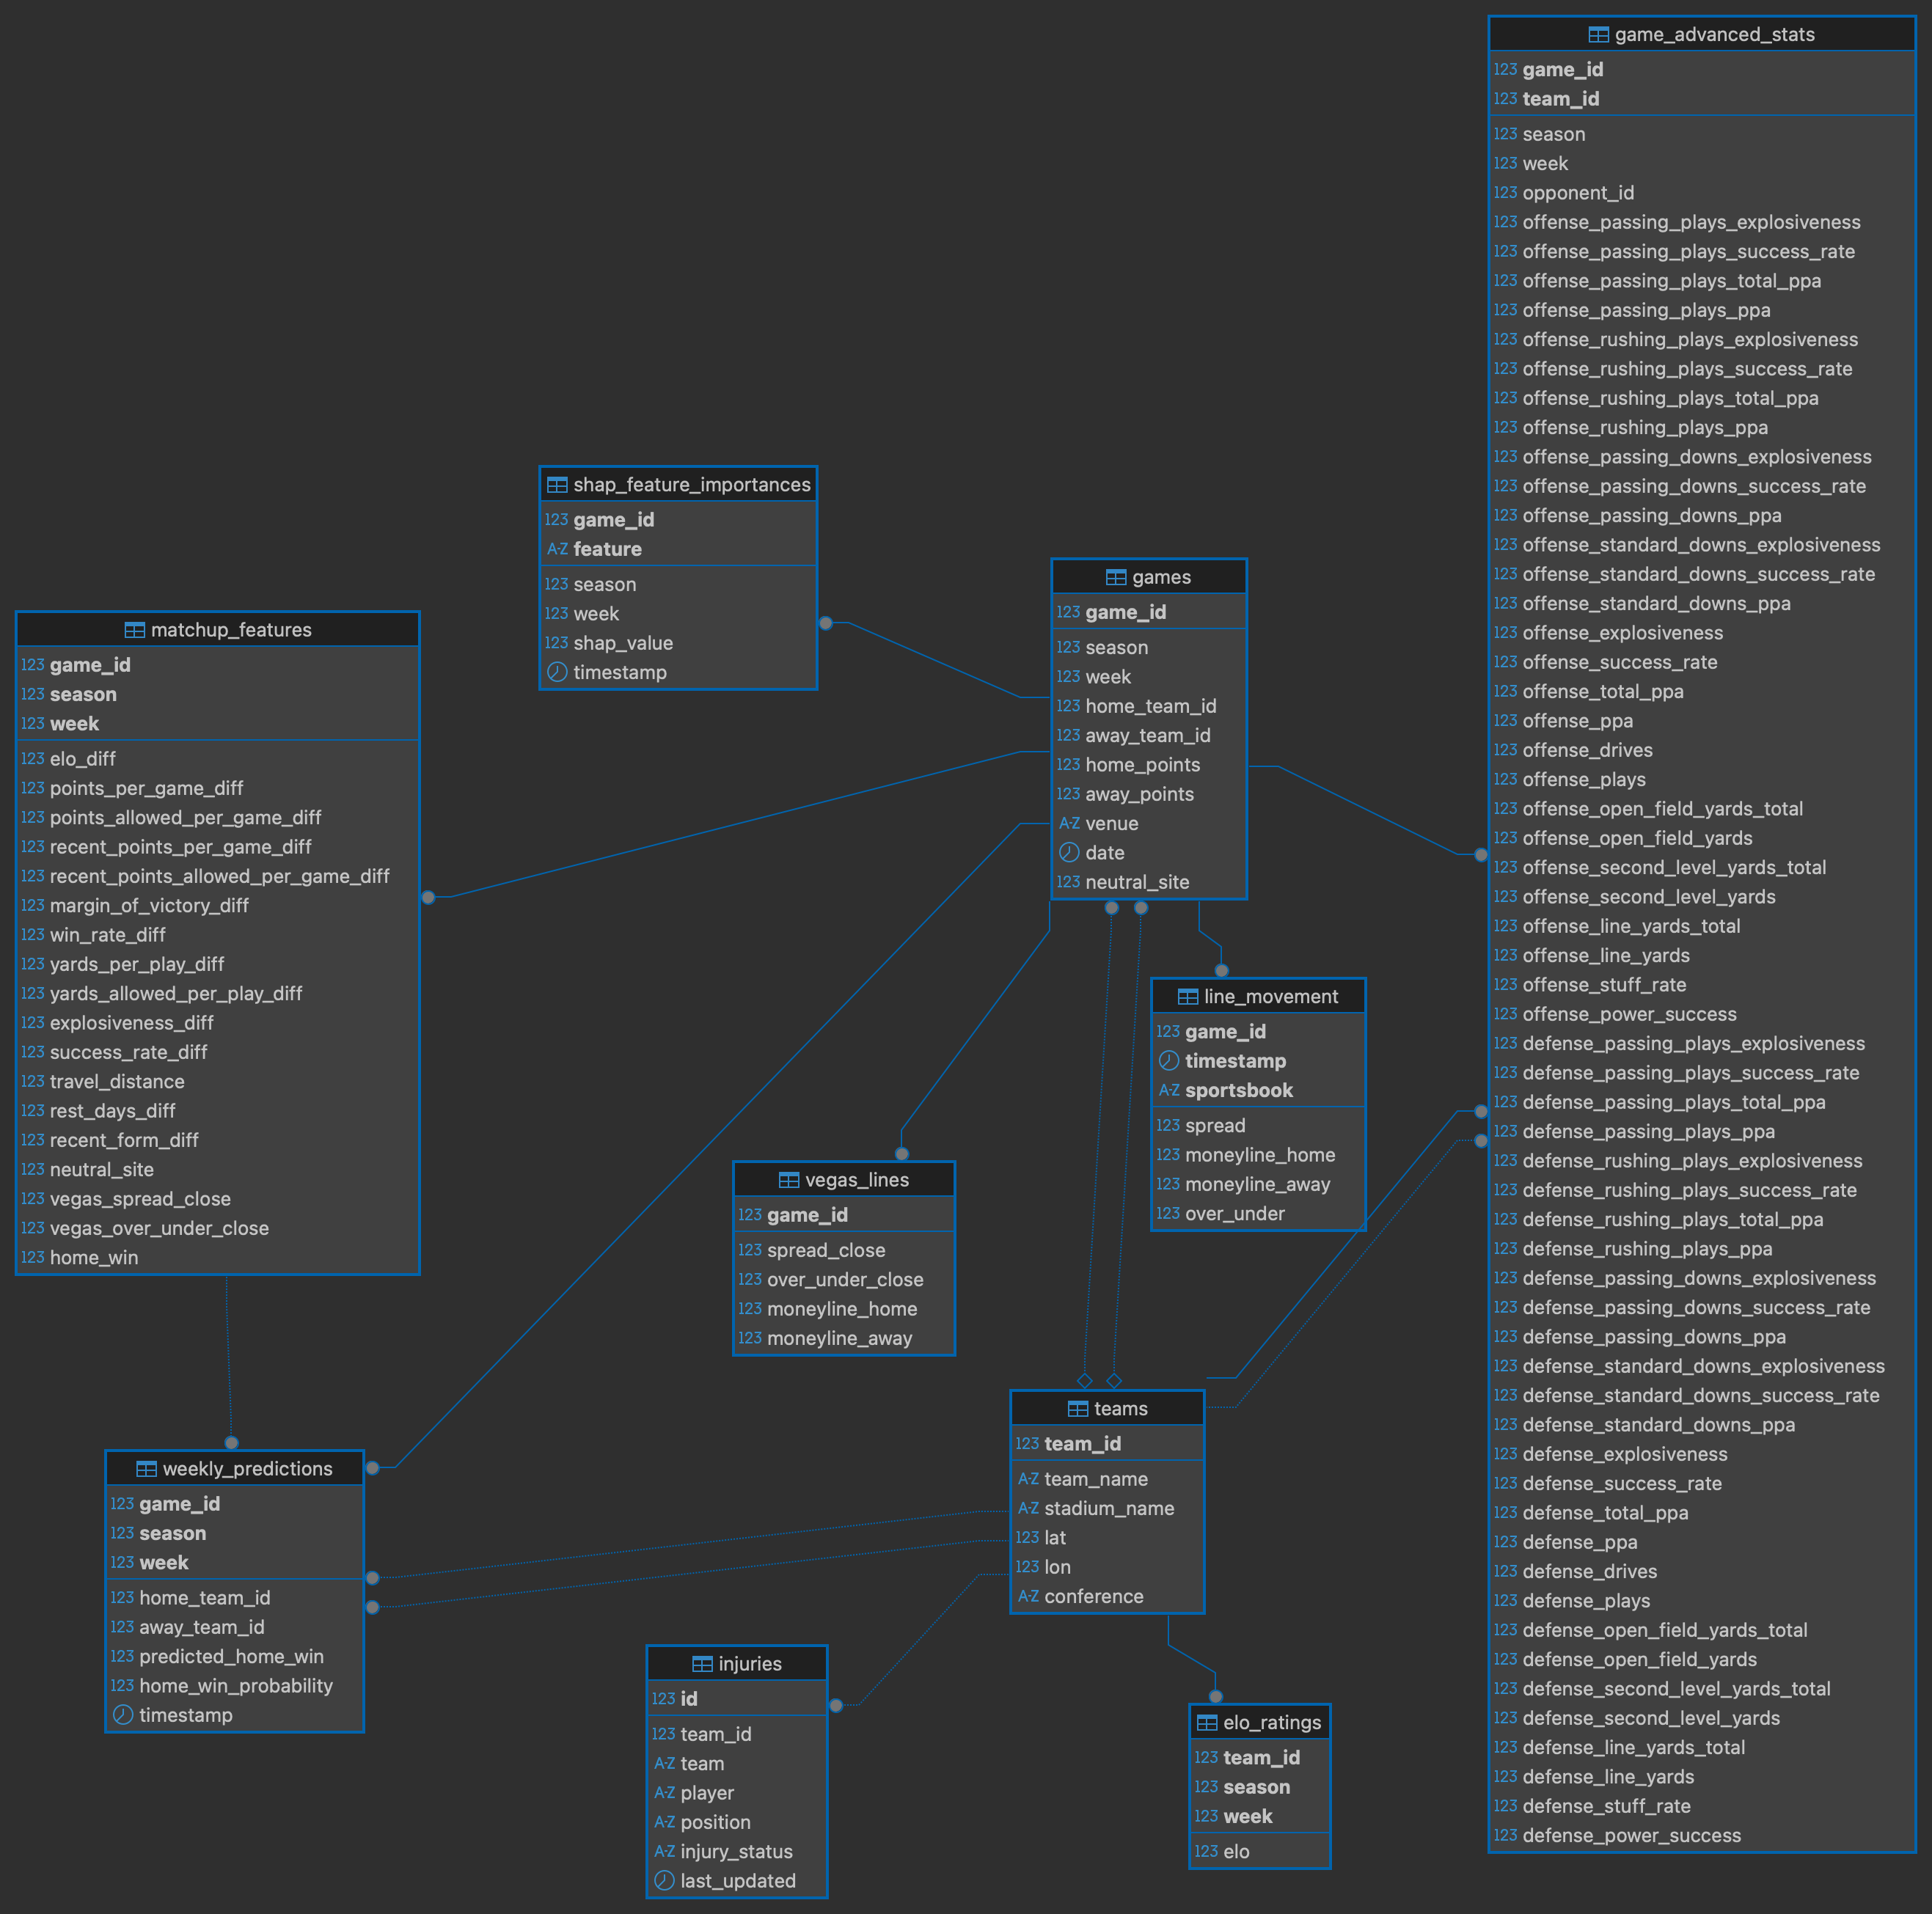

Slide 17
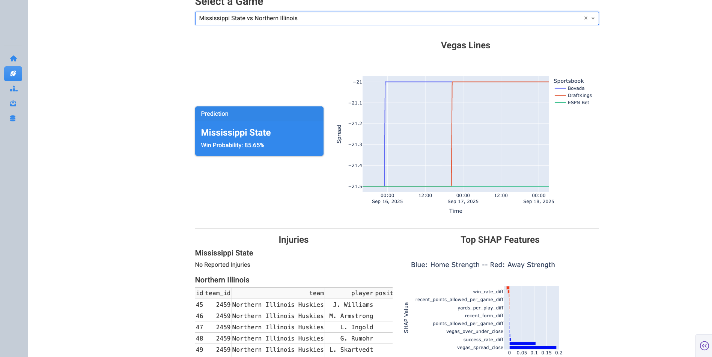

Slide 18
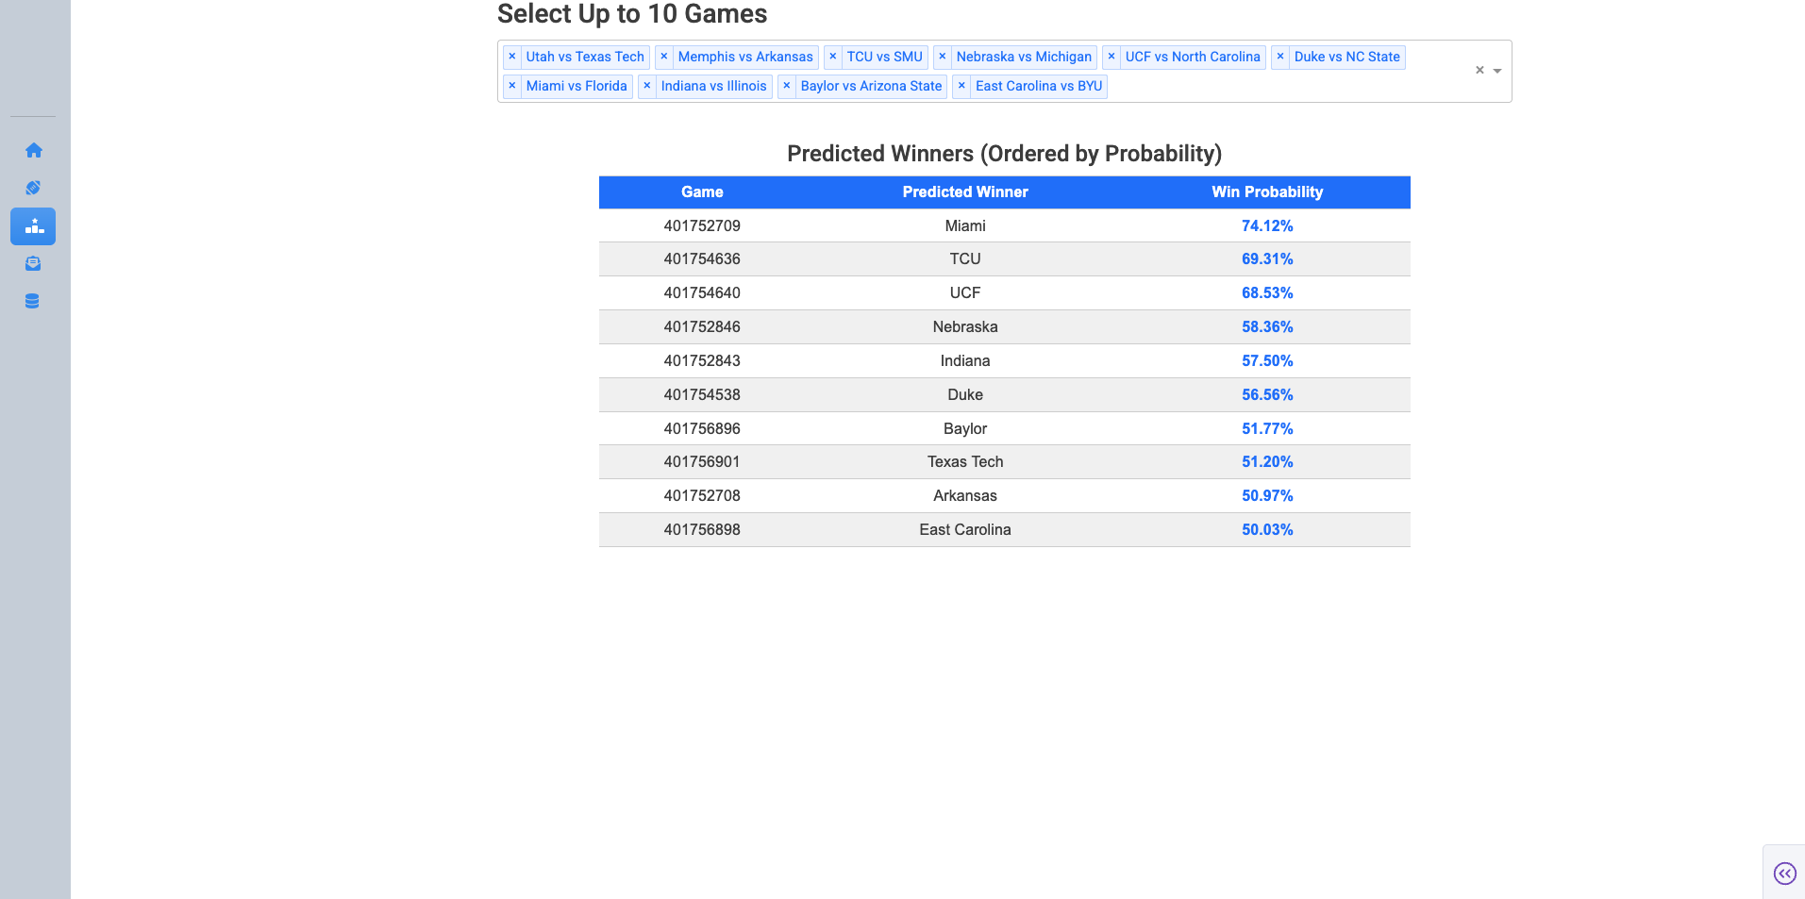

Slide 19
Conclusion & Next Steps
Sharp Money Detection
Iterate through feature selection process
Use ‘points’ as a target variable
Include team profiles in Dashboard
Quantify impact of injuries

Slide 20
Q&A
Thank you!
Questions?

